Slide 1
ELT Kimball Modeling with Visual Metabase
DataCraft :
Dibimbing.id – Final Project Data Engineer Batch 2
Muhammad Muhidin

Slide 2
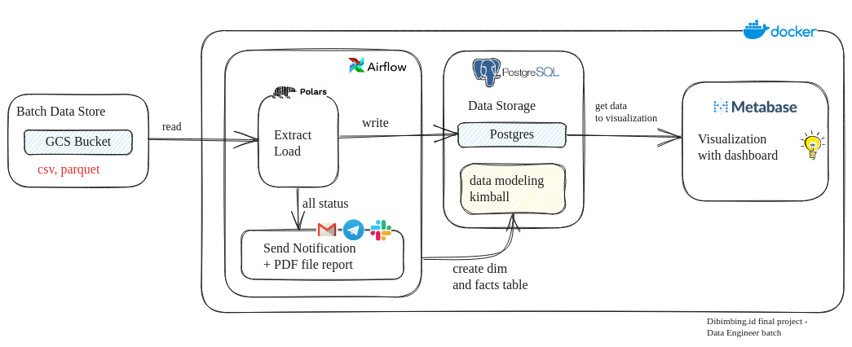
Infrastructure of Pipeline
Raw data from GCS is extracted by Polars in Airflow and then loaded into Postgres. then Airflow runs the SQL file containing the dim and fact creation. All status instances are sent to email with attachments, telegram and slack. After the dim and data data are created, the metabase reads Postgres for visualization.

Slide 3
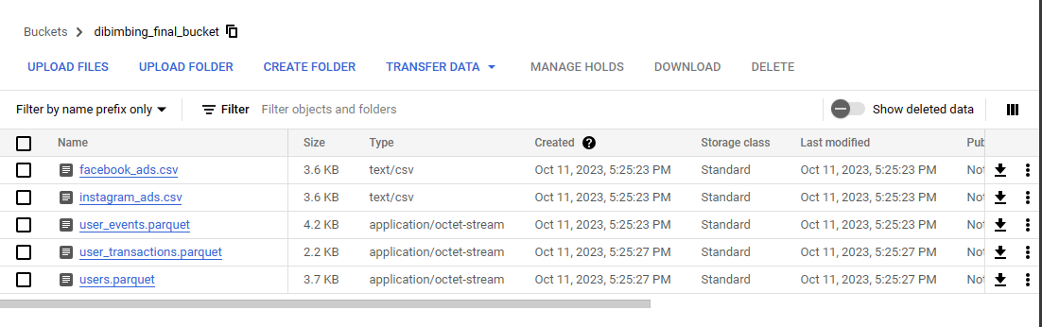
Raw Data in Google Cloud Storage
Raw data in Google Cloud Storage is in the format of CSV and Parquet files.

Slide 4
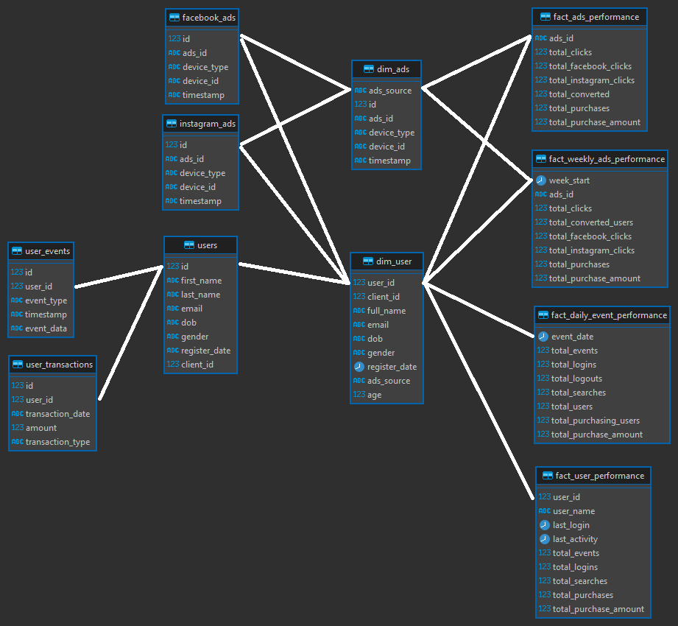
Entity Relationship Diagram (ERD)
relations from dim and fact tables

Slide 5
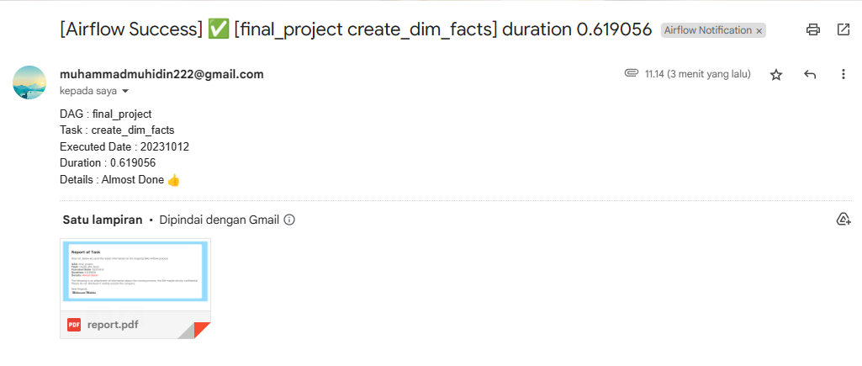
Email Notifications

Slide 6
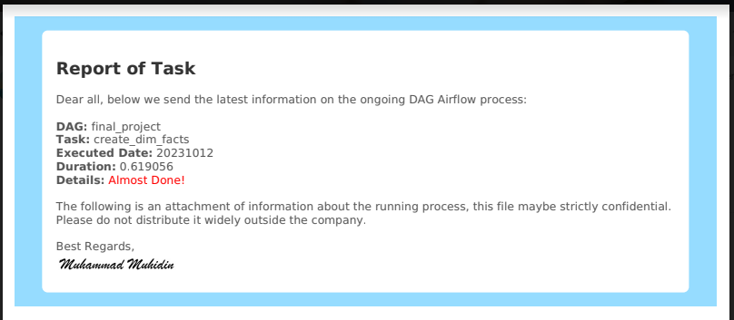
Report Attachment (Email)

Slide 7
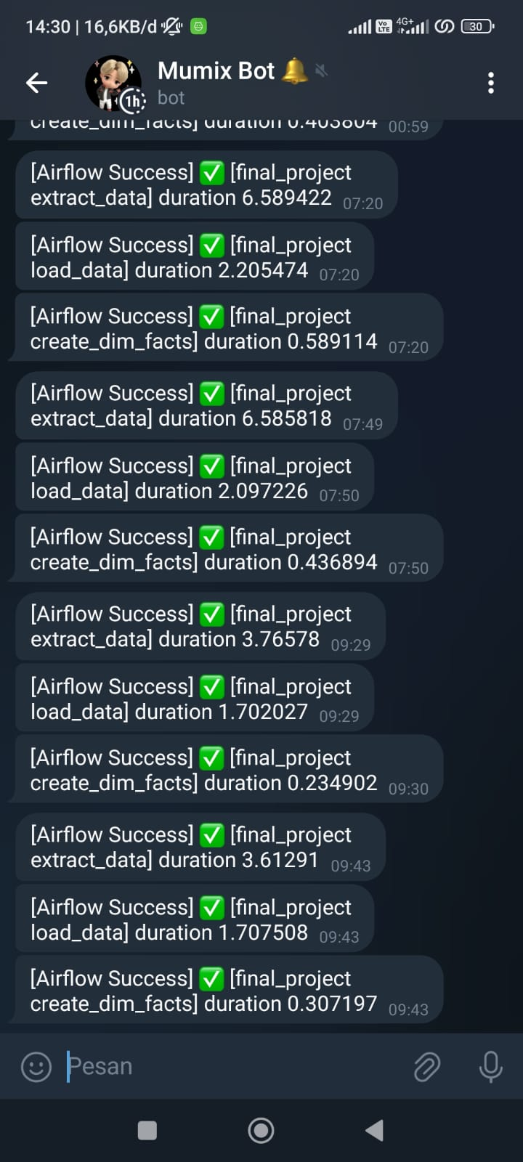
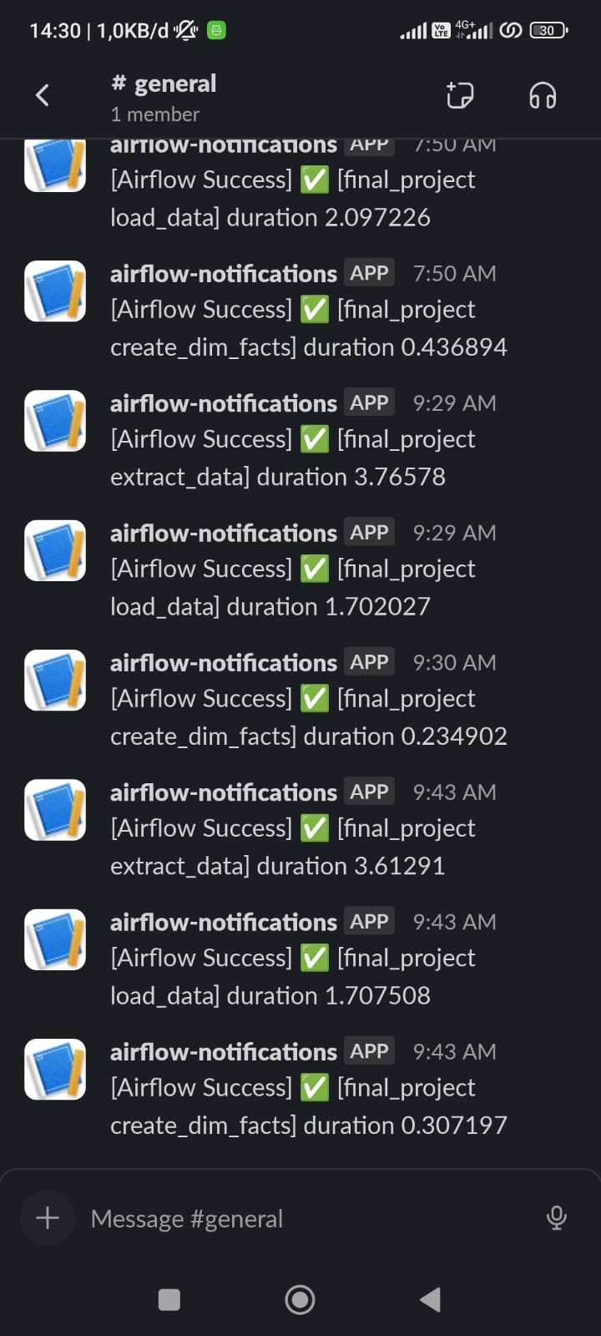
Telegram and Slack Notifications
all statuses on the airflow task instance are success, retry, failure. Also sent to Telegram and Slack.

Slide 8
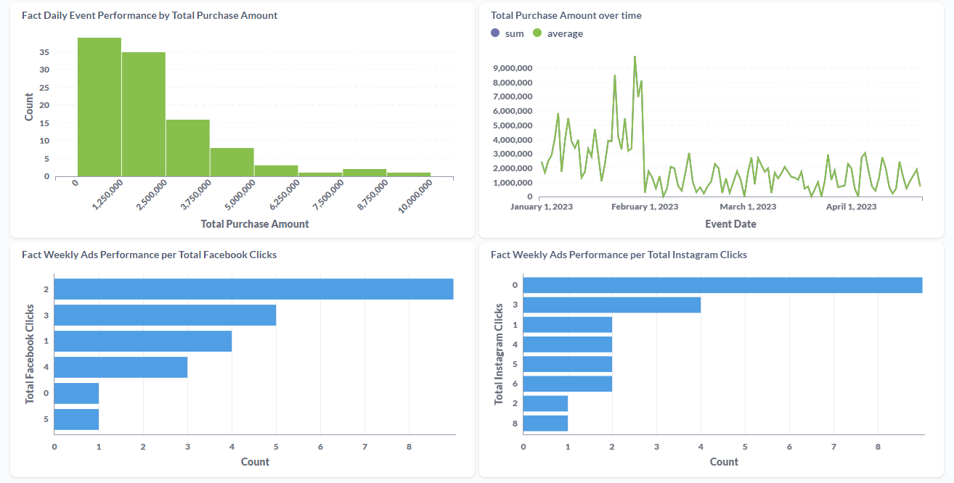
Dashboard of Metabase

